Slide 1

Web scraping to gain company insights
19/11/2022

Slide 2
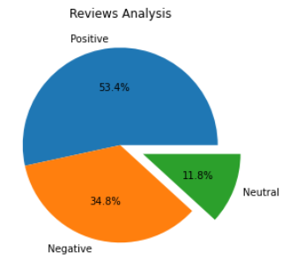
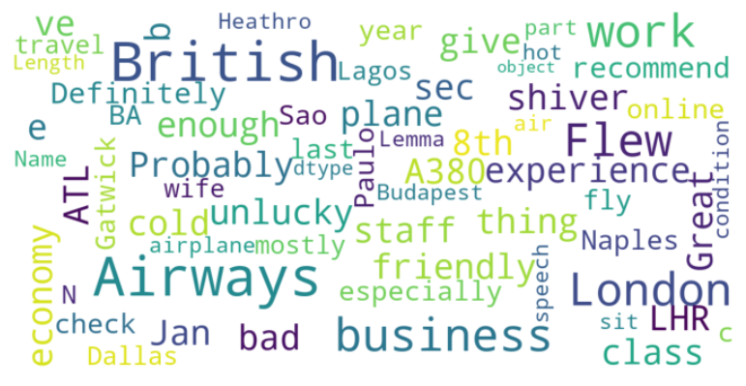
INSIGHTS FROM CUSTOMER REVIEWS
From cleaning 1000 reviews given by the customers, we obtained the following results:
Positive Reviews – 534
Negative Reviews - 348
Neutral Reviews – 118
Key Words Used In Reviews:

